Slide 1

Work-Case 3
Робили:Мірошніченко А., Михальов В.

Slide 2
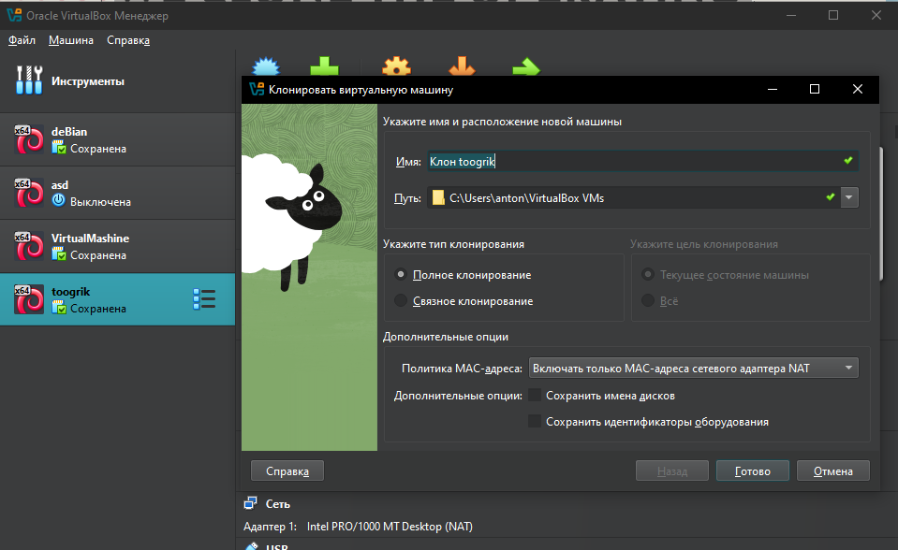
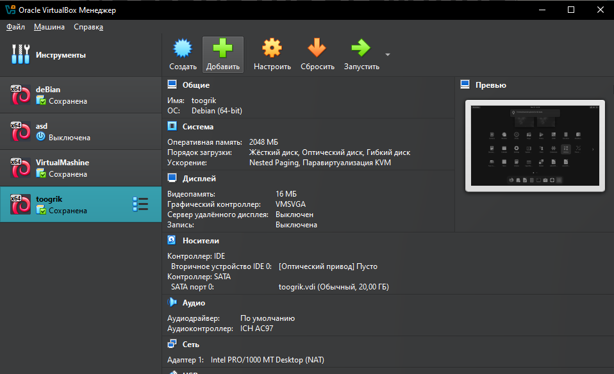
OS cloning
To clone, you need to select the portable OS and press ctrl + o, or three dashes and "Clone"

Slide 3
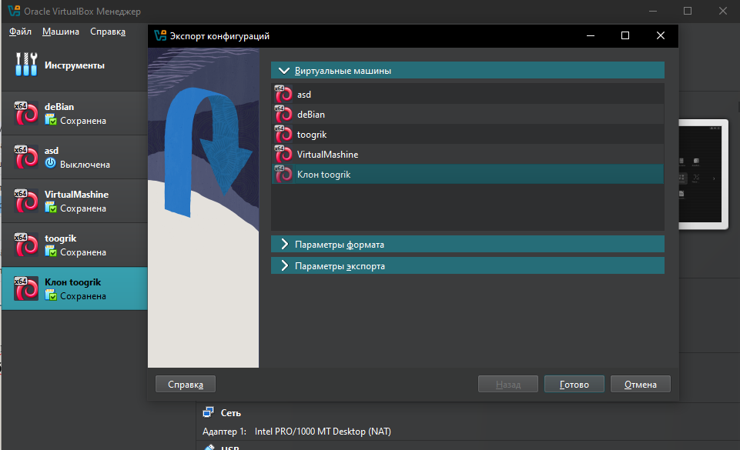
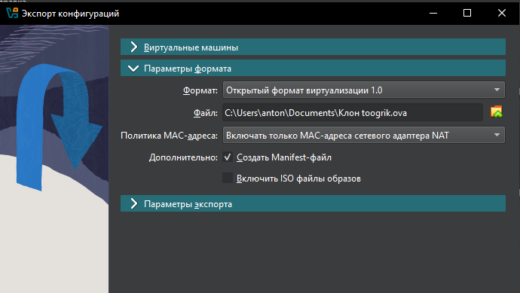
Transfer
If you need to move the clone to another virtual environment, you need to click ''File'' and export, select from where and where you want to export.

Slide 4
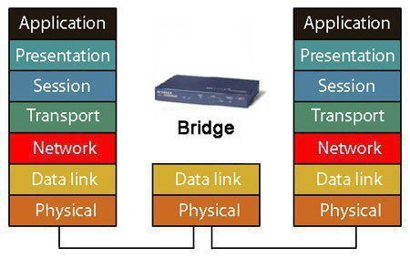
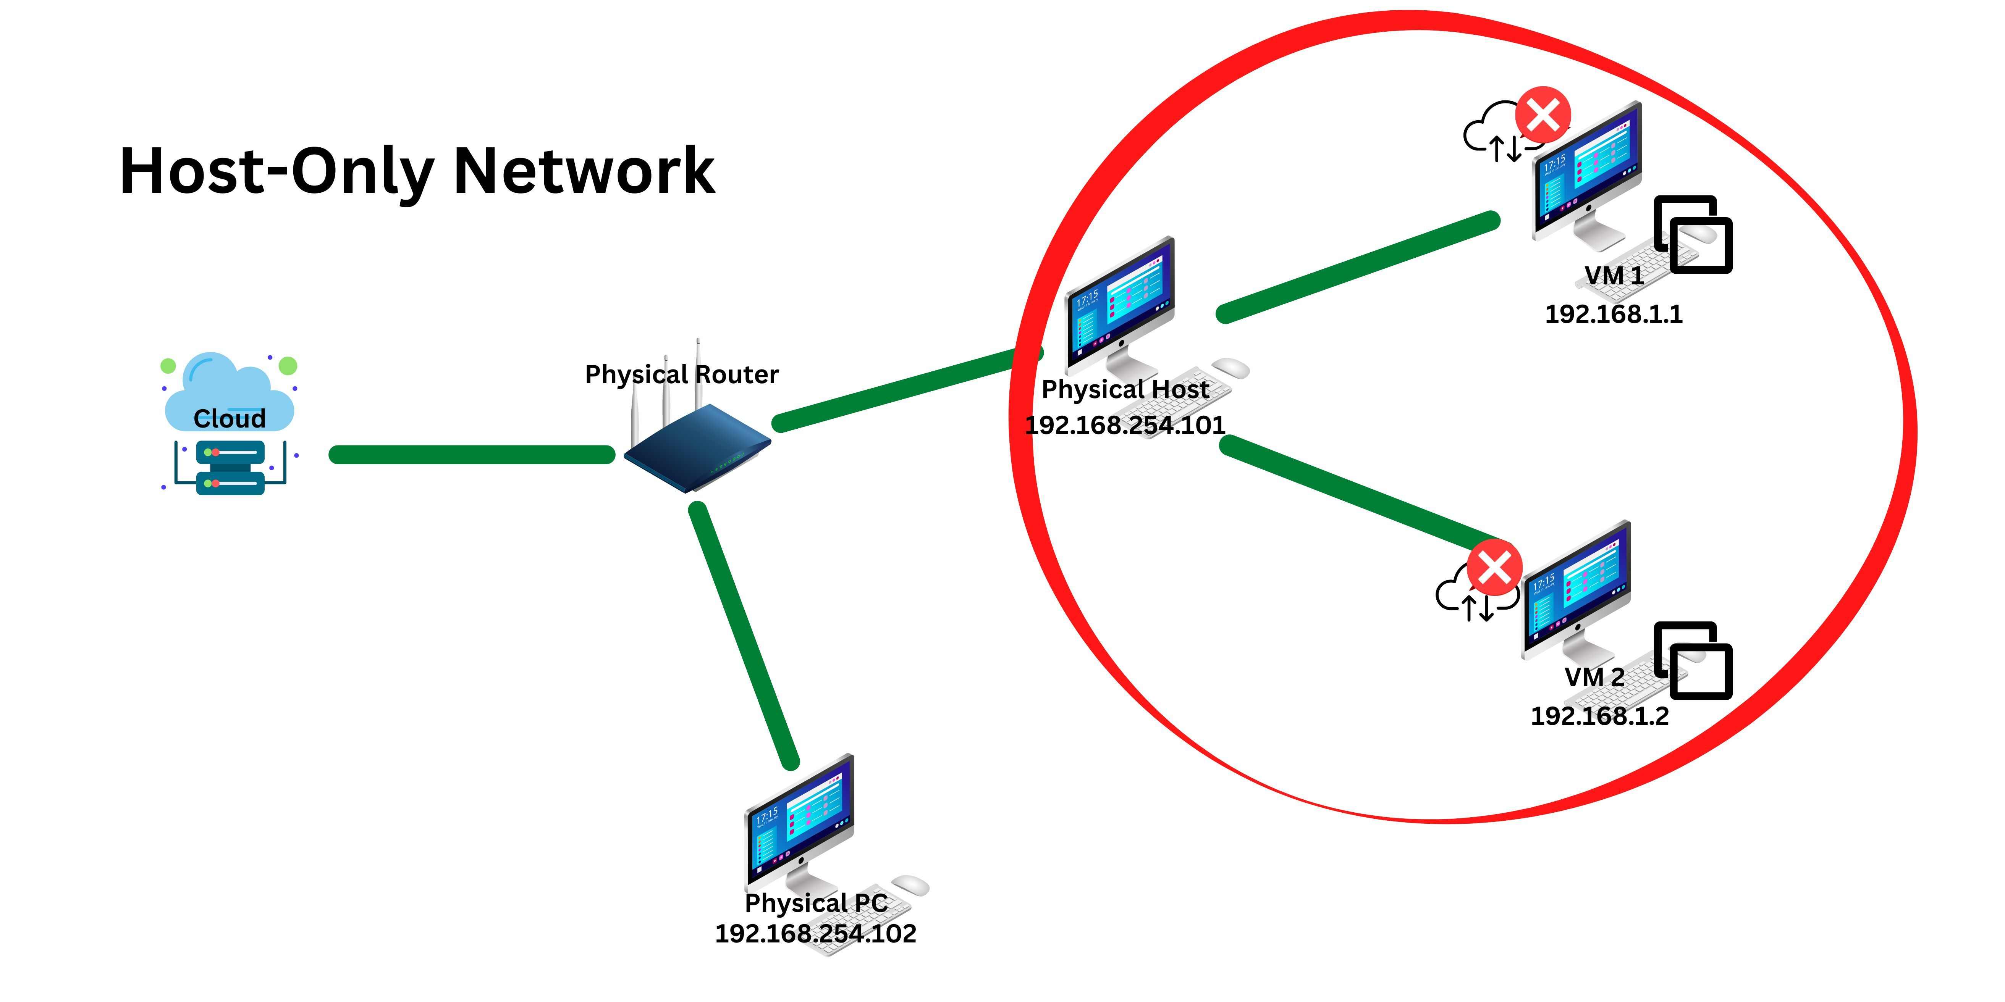
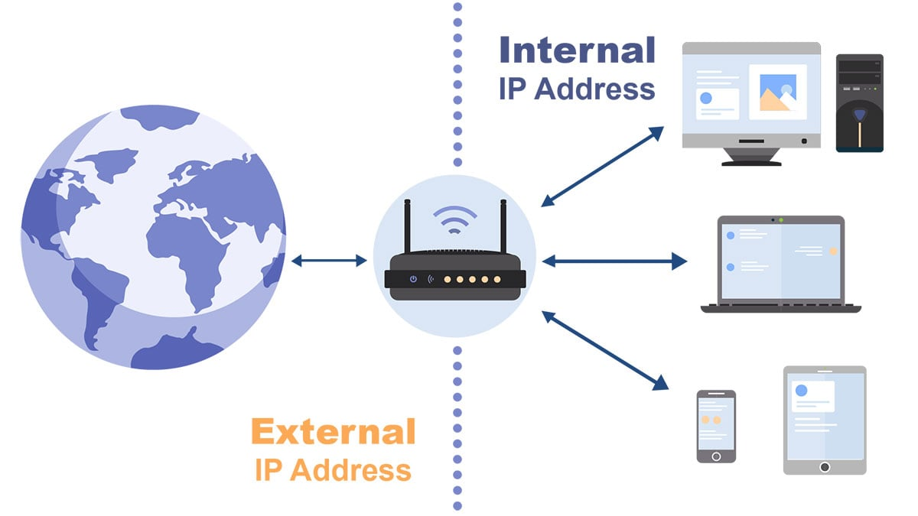
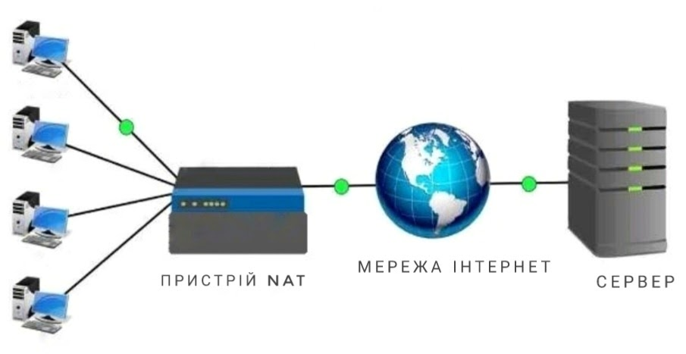
Network connections
NAT is a technology that redirects traffic between local and global networks. It allows you to use one IP address to connect several devices to the Internet.
Bridged - A bridge is a network equipment whose main purpose is to connect computer network segments of different topologies and architectures.
Host-only - allows you to create connections between logical partitions without using physical hardware
Internal Network is a computer network that is used for communication between devices within an enclosed space

Slide 5
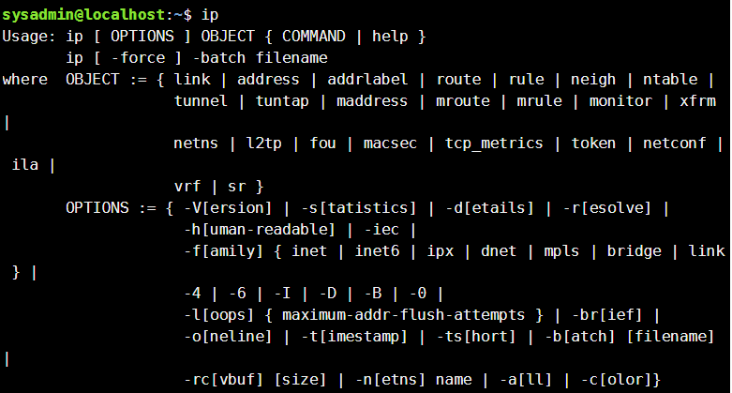
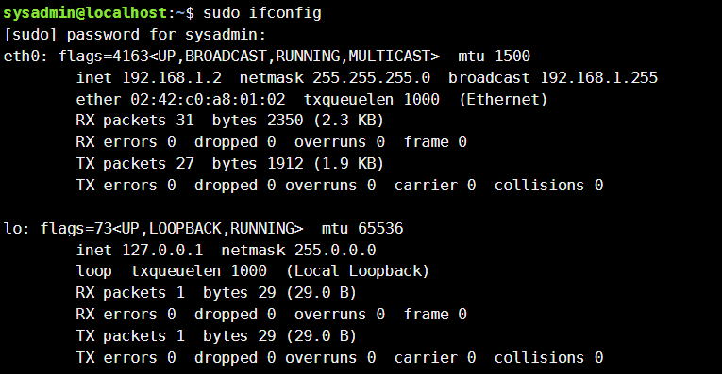
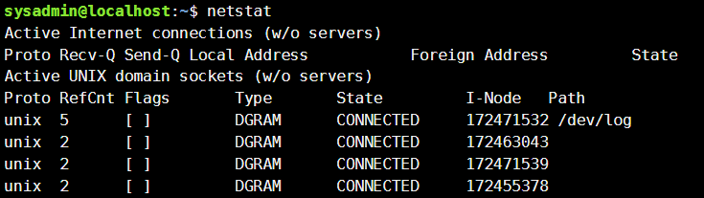
EXAMPLES OF BASIC COMMANDS IN THE TERMINAL FOR CONFIGURING NETWORK PARAMETERS
ifconfig
ip
netstat

Slide 6
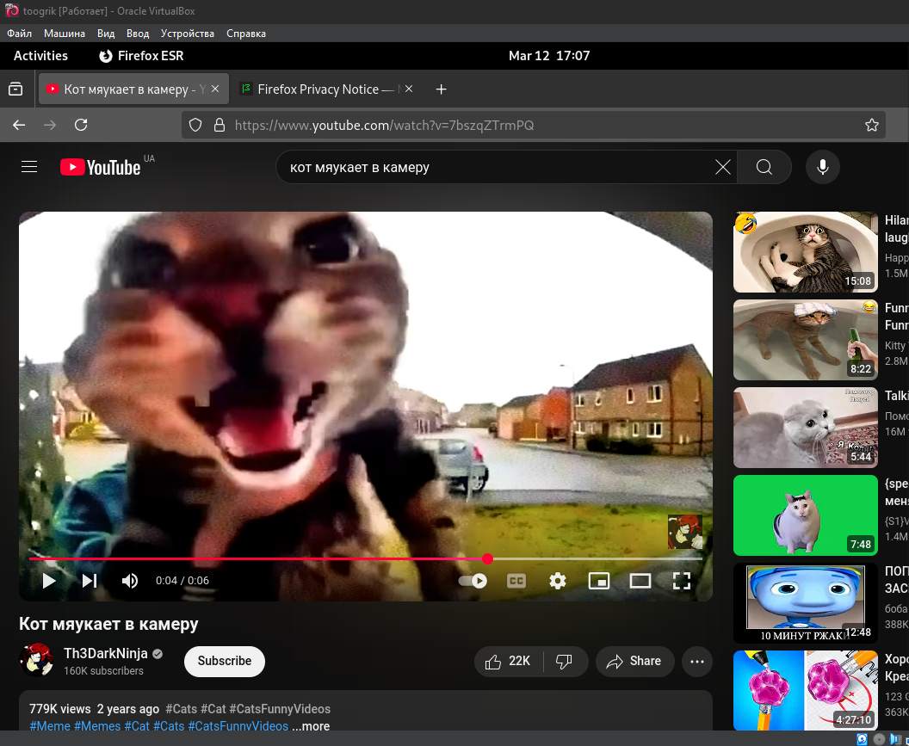
Internet connection

Slide 7
Setup and demonstration between two OS over the network
First to do this, you need to enter the command “nc -l -p [selected_port]” on the first computer
And second, on the second “nc IP address of the first computer [selected_port]”.

Slide 8
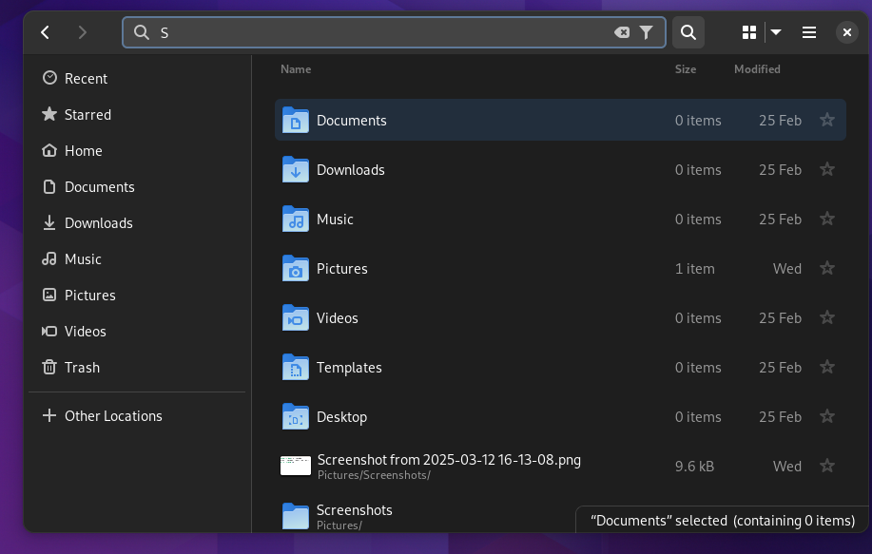
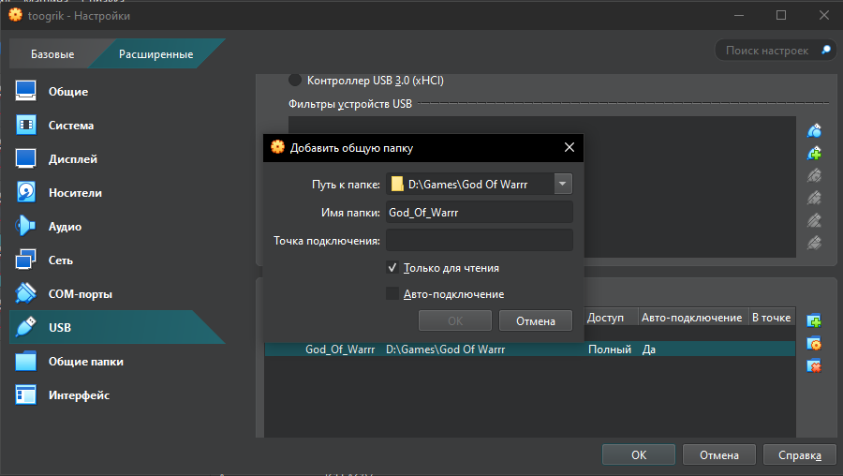
EXCHANGE OF INFORMATION BETWEEN WINDOWS AND LINUX
open virtual machine settings --> usb, select the folder

Slide 9
EXCHANGE OF INFORMATION BETWEEN LINUX AND WINDOWS
To transfer a file from Linux to Windows, you need to do the same thing but in reverse.

